Slide 1
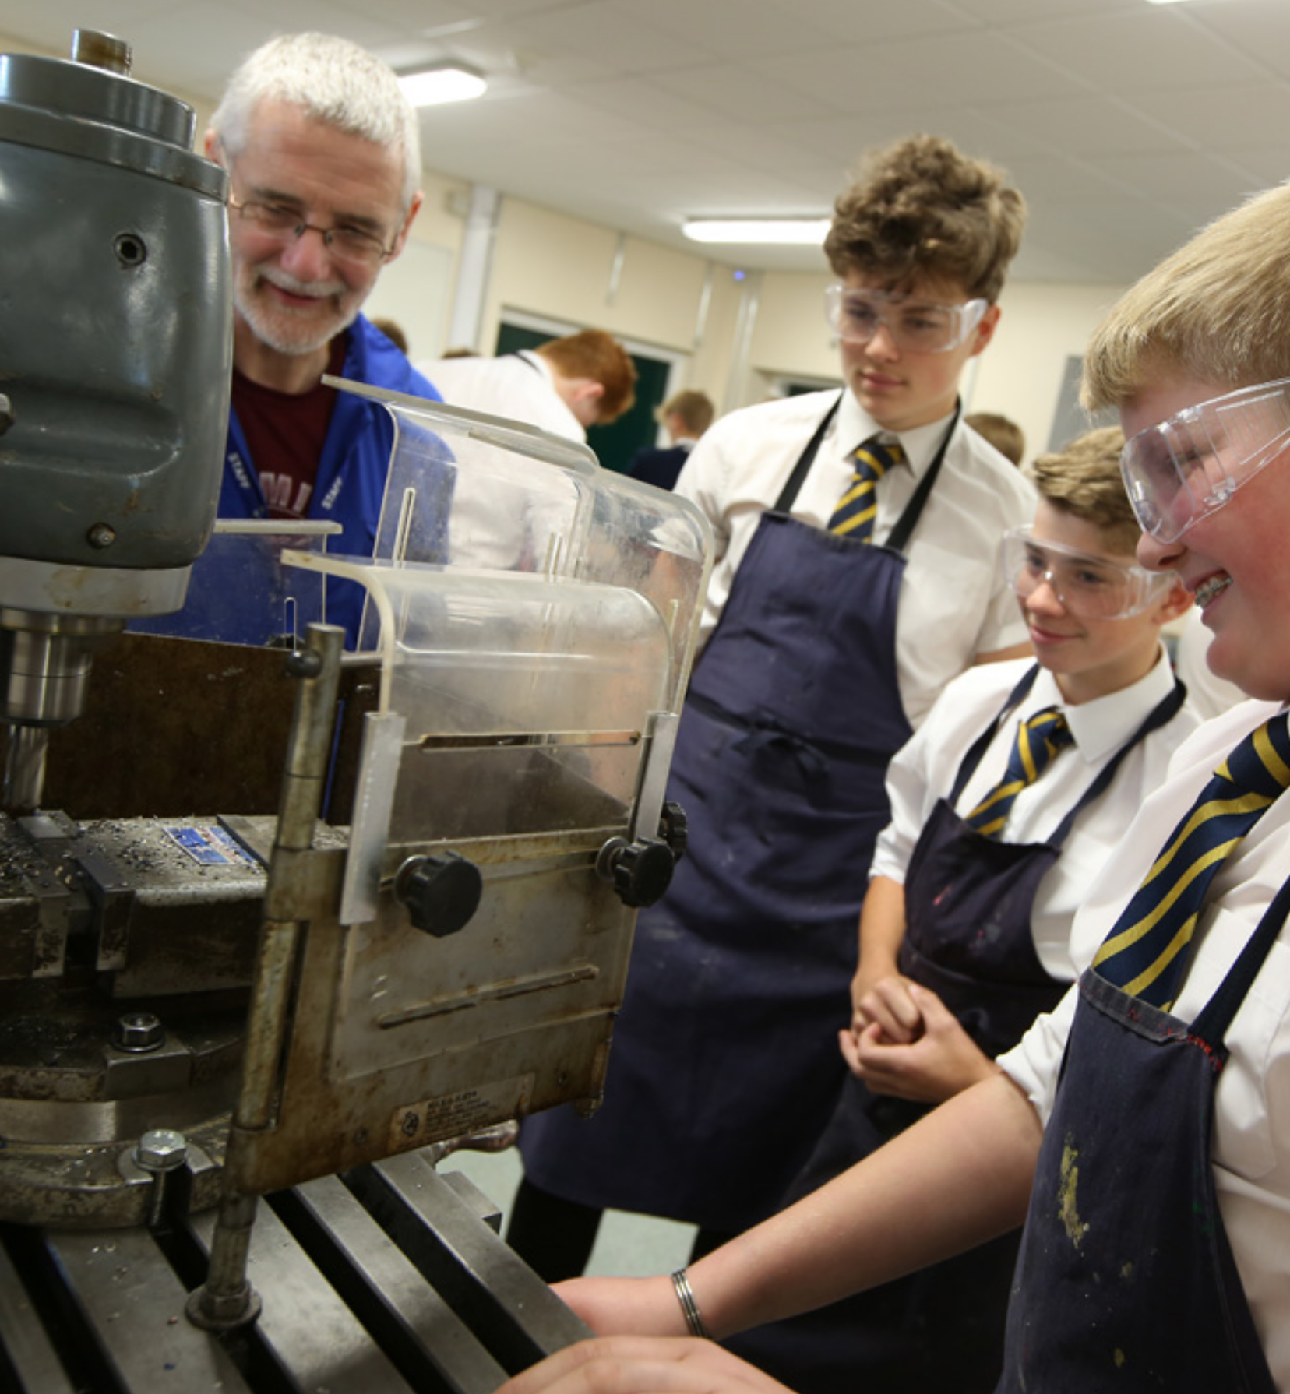


WJEC Engineering level 1/2 award
Engineering
Notes:
Welcome to this short presentation on why WJEC engineering may be the course for you. We’re going to have a look at why this course may suit your interests, your way of thinking, your future aspirations for further education or the start of a career. We’ll have quick look at what the course covers over the two years and where it could lead you.

Slide 2


Engineering
Why Engineering?
Technical knowledge
Practical skills
Peer feedback
Problem solving
Regular deadlines
Preparation for careers in engineering
Notes:
The world around us has been designed and made by engineers, from your phone, to your house and street, to aeroplanes, boats, bridges, fridges - every product has been made by an engineer.

Slide 3
Engineering
The Course
Year 10
Combination of theory and practical to support Y11 assessment work including
OnShape - CAD
Isometric, orthographic and section views using drawing boards
Properties of materials
Selection of tools and equipment
Practical skills using tools and equipment
Mock unit 1 and 2 assignments
Year 11
Unit 1 – make – worth 40% of qualification
You will make an engineering component, set by the exam board
You will make this completely independently – no help from me!
You will gain a mark according to the accuracy of this
Unit 2 – design – worth 20% of qualification
You will revisit the component you have just made in unit 1, and redesign it according to the exam board requirements
You will redesign this completely independently – no help from me!
You will gain a mark according to the accuracy of this
Unit 3 – exam – 40% of qualification
You will apply our knowledge to a formal exam
Notes:
In year 10 you will be developing the skills and acquiring the knowledge you will need to be successful in Y11.
You will cover areas such as CAD/CAM, drawing board drawing skills, properties of materials and the selection and safe use of a variety of tools and equipment including the centre lathe and the brazing hearth.
You will use these skills and knowledge to gain experience in mock units 1 and unit 2, in preparation for Y11
In year 11 you will complete 40% of the qualification carrying out a product investigation and manufacture, set by the exam board. This will be an active exam, delivered by the teacher, in the workshop/classroom. Following this, you will complete 20% of the qualification producing a design specified by the exam board. Again, this will be delivered by the teacher, in the workshop/classroom. The final 40% will be achieved through an exam at the end of the year.
It is important to note that although this is GCSE equivalent, it is not a GCSE.

Slide 4
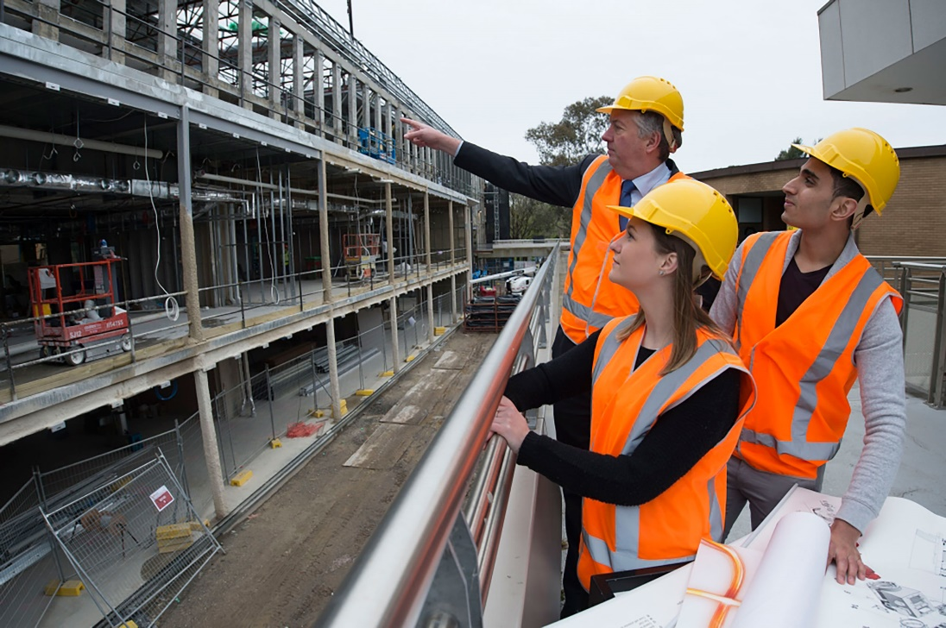
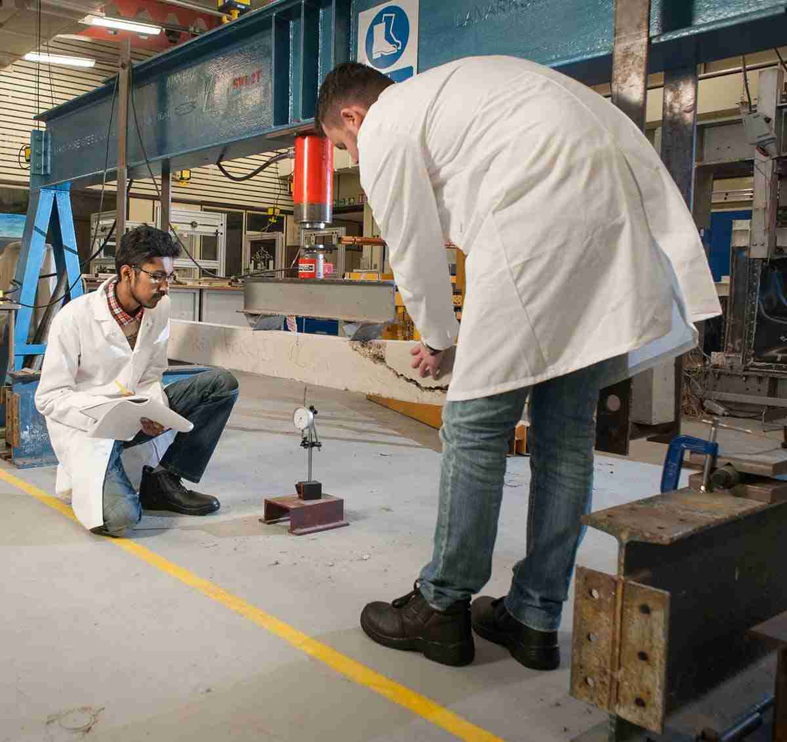
Engineering
Where could it take you?
Engineering Apprenticeships
Product Design
Transport Design
Model Making
Architecture
Engineering
CNC Machinist
Manufacturing
The Armed Forces
Notes:
WJEC Engineering leve1/2 award can prepare you for a whole host of different courses and jobs involving practical design and problem solving, from Engineering Apprenticeships to begin a career in engineering, to University courses in engineering

Slide 5

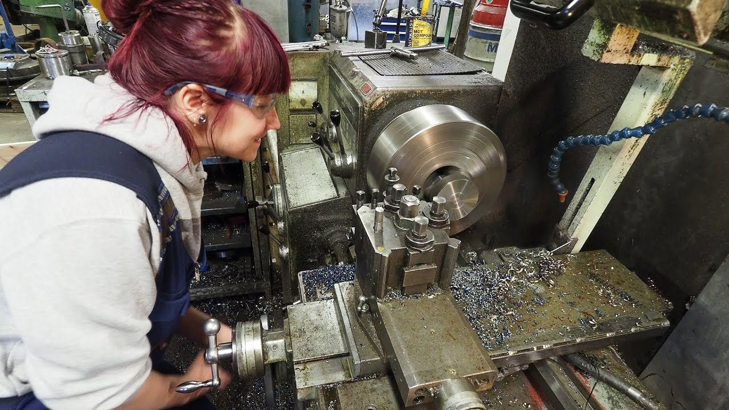
Engineering
Consider Engineering
Notes:
If you’re an organised learner who can produce written and practical work to a high standard, appreciates regular deadlines and working with a range of tools and equipment, then Engineering might just be for you.

